Slide 1

Spotify Music Analytics: Marketing Strategies
This research explores Spotify's extensive music dataset to uncover insights that optimize marketing strategies. By analyzing audio features like danceability, energy, valence, and tempo alongside popularity metrics, the study aims to guide artists, record labels, and marketers in making data-driven decisions.
The project employs data analytics techniques to segment songs, identify correlations, analyze genre trends, and evaluate artist performance, offering a framework for targeted promotion and playlist optimization on digital platforms.

Slide 2

Dataset Overview and Key Features
Dataset Characteristics
Audio Features
~114,000 tracks across 125 genres
Danceability, energy, valence, tempo
20 features including metadata, audio, and popularity
Loudness, acousticness, instrumentalness
Popularity score from 0 to 100
High data quality with minimal missing values

Slide 3
Research Methodology and Important Columns
Track and Artist Metadata
Audio and Popularity Metrics
Technical Features
Tempo, key, mode, and duration provide additional context for music consumption patterns and marketing optimization.
Includes track ID, name, artists, album, and genre for content identification and marketing targeting.
Features like danceability, energy, valence, and popularity score inform listener engagement and campaign strategies.

Slide 4

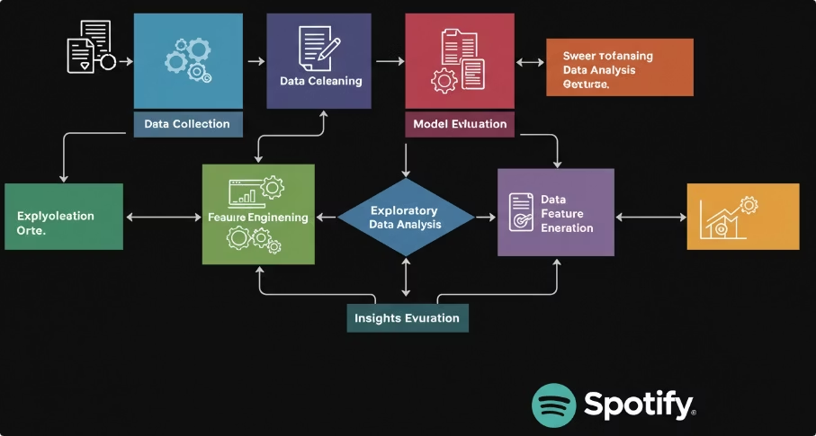
System Architecture and Data Pipeline
Data Ingestion & Preprocessing
Model Development & Evaluation
Load streaming data, clean missing values, remove duplicates, and encode variables.
Train Linear Regression model with train-test split; evaluate using R², MAE, RMSE metrics.
Insights & Output
Generate performance dashboards, prediction APIs, and visualizations for marketing strategy.

Slide 5
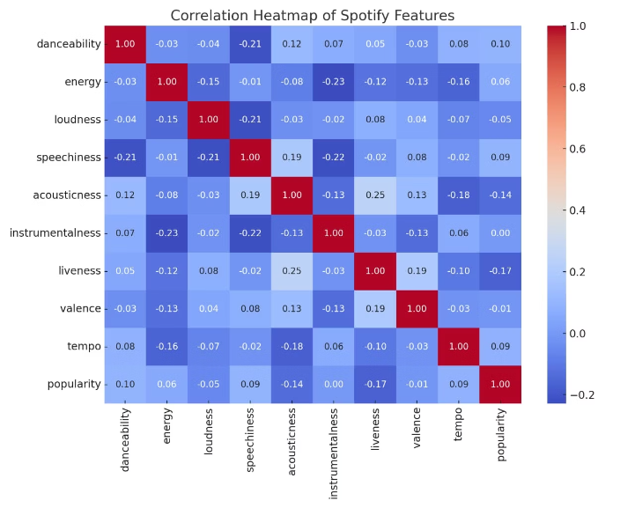
Data Analysis and Exploratory Insights
Preprocessing Highlights
No missing values; 3 duplicates removed
Outliers retained as valid viral tracks
New features: Engagement Rate, Cost per Stream, Stream Completion Rate
Exploratory Findings
Strong correlations: Stream Count & Playlist Adds (0.79), Artist Popularity (0.81)
Podcast content shows higher completion rates than music tracks
Weekend streams 23% higher than weekdays

Slide 6

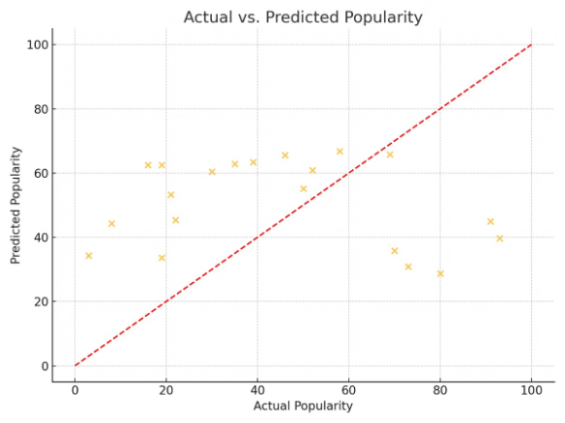
Model Training and Evaluation
0.892
2845
7234
R-squared (R²)
Mean Absolute Error (MAE)
Root Mean Squared Error (RMSE)
Explains 89.2% variance in stream count
Low error indicates accurate predictions
Confirms model reliability for forecasting
Residual analysis shows no major patterns, confirming model assumptions and consistent performance across genres.

Slide 7

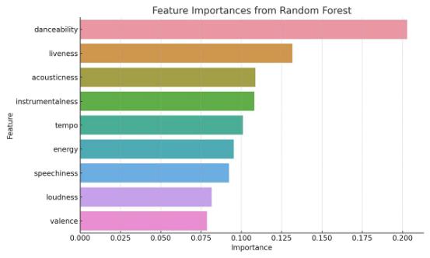




Findings and Industry Comparison
Playlist Placement Drives Discovery
Algorithmic playlists significantly boost streaming numbers and engagement.
Stream Completion Rate Matters
Higher completion rates indicate better content quality and reduce promotional needs.
Content Type & Audience Impact
Podcasts retain listeners longer; premium users show higher engagement than free tier.
Industry Trends Alignment
Data-driven curation and multi-format optimization enhance user retention and satisfaction.

Slide 8
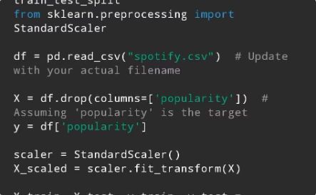
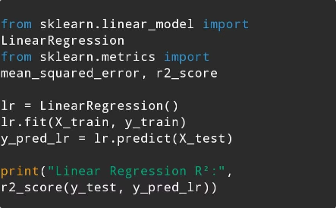
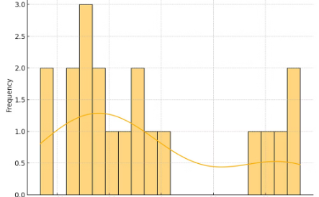
Code and Data Visualizations
Data Processing
Python code for data cleaning, feature engineering, and preprocessing.
Linear Regression Model
Implementation of the regression model for stream count prediction.
Residuals Distribution
Visualization confirming model assumptions and prediction accuracy.

